Slide 1
CAPSTONE PROJECT PRESENTATION
PROJECT:
CUSTOMER CHURN PREDICTION FOR AZUBIAN
(Telecom Customer Churn Prediction)
FK Baffour​

Slide 2
OVERVIEW
Telecom companies face major challenge with customer churn, as customers switch to alternate provider due to several reasons. Understanding the customer is of the utmost importance and understanding their behavior patterns can lead to very impactful business decisions.
OBJECTIVE: The objective of this project is to develop a machine learning model to predict the likelihood of each customer “churning,” i.e. becoming inactive and not making any transactions for 90 days.
NEXT STEPS:
Data Understanding
Data Preparation
Modeling
Evaluation
Deployment
1

Slide 3
Data UNDERSTANDING
Train data: 1,077,024 rows and 19 columns,
Test data: 190,063 rows and 18 columns.
Target:
- CHURN (binary)
Categorical Features:
- REGION - TENURE - MRG - TOP_PACK
Numerical Features:
- MONTANT - FREQUENCE_RECH - REVENUE - ARPU_SEGMENT
- FREQUENCE -DATA_VOLUME -ON_NET - ORANGE TIGO -ZONE1
- ZONE2 -REGULARITY - FREQ_TOP_PACK

Slide 4
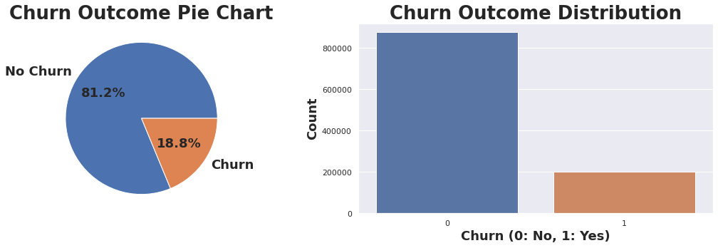
Target- Customer Churn
Predictor Class is not balanced

Slide 5
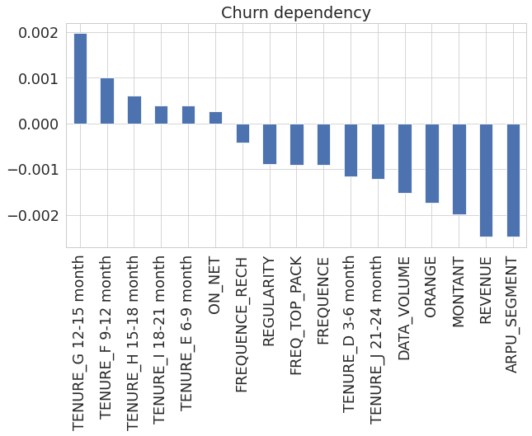
DATA PREPARATION
Selecting the most Interesting Features
columns with over 50% missing data were dropped
user_id was dropped because it will not be relevant in training our model
MRG since it contains just one unique value among all customers, so it was dropped
TOP_PACK was dropped since it has about 126 unique values which is difficult to group into smaller groups
'11’ interesting feature were selected to use for the next steps:
Numeric features : 10
Categorical features : 1
Splitting Train Dataset:
Train dataset was splitted into train and evaluation set( test size=20%)
Normalization and Encoding the dataset:
Pipeline for the Numeric features
Imputer: Simple Imputer (strategy= mean)
Scaler: Standard Scaler
Pipeline for the Categorical features
Imputer: Simple Imputer (strategy= most frequent)
Encoder: One Hot Encoder
Overcoming Class Imbalance: SMOTE sampling Techniques

Slide 6
modelling
Six Trained models
Hyperparameter tunning
Six classification models were trained:
1. Decision Tree Model
2. Gradient Boosting Model
3. Logistic Regression Model
4. Stochastic Gradient Descent
5. Random Forest Model
6. Ada Boost Classifier Model
Ada Boost Classifier
(Grid Search CV)
Grid_params
n_estimators: [100,200,300,400]
best.param = 400 with score 0.8993
Random Forest Classifier
(Randomized Search CV)
best_params
n_estimators= 100, min_samples_split= 7, min_samples_leaf= 9, max_features='log2', max_depth= 16, criterion= 'gini’
score = 0.8648

Slide 7
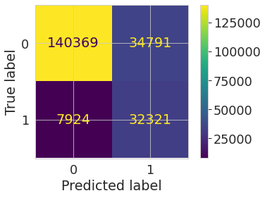
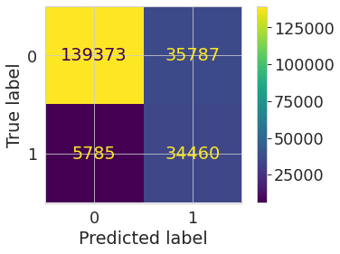
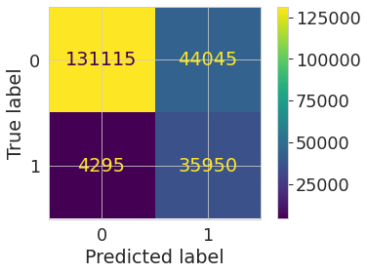

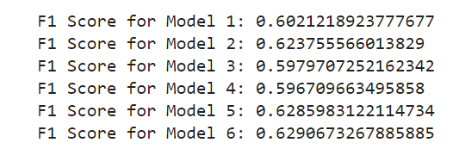
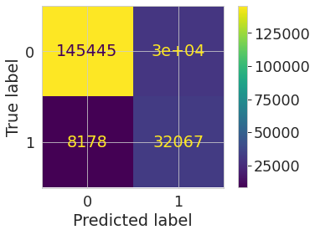
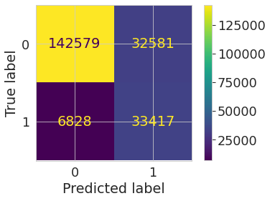
evaluation
F1 Score was used in evaluating the initial 6 trained models to select best performing models
ROC_AUC Score was used during hyperparameter tunning

Slide 8
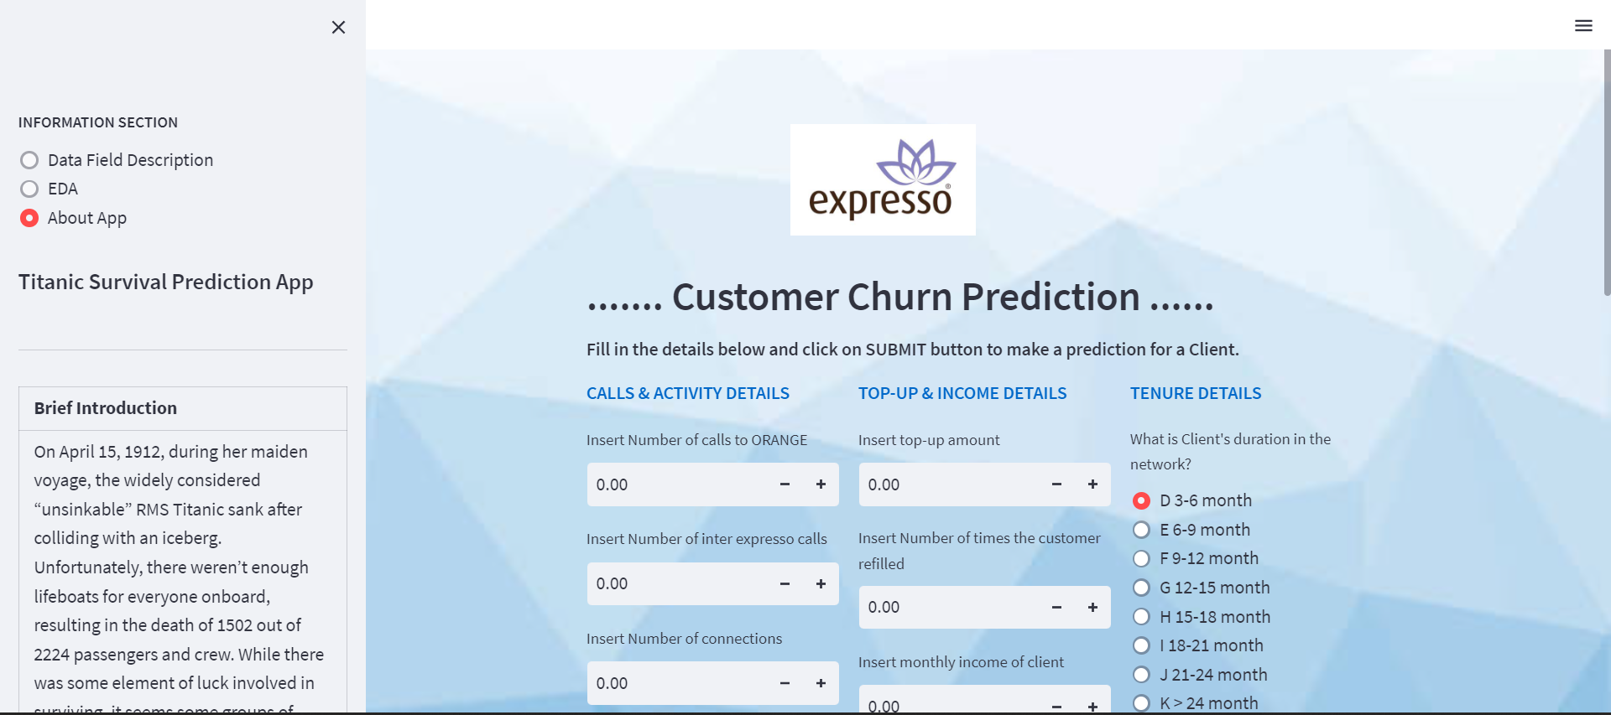
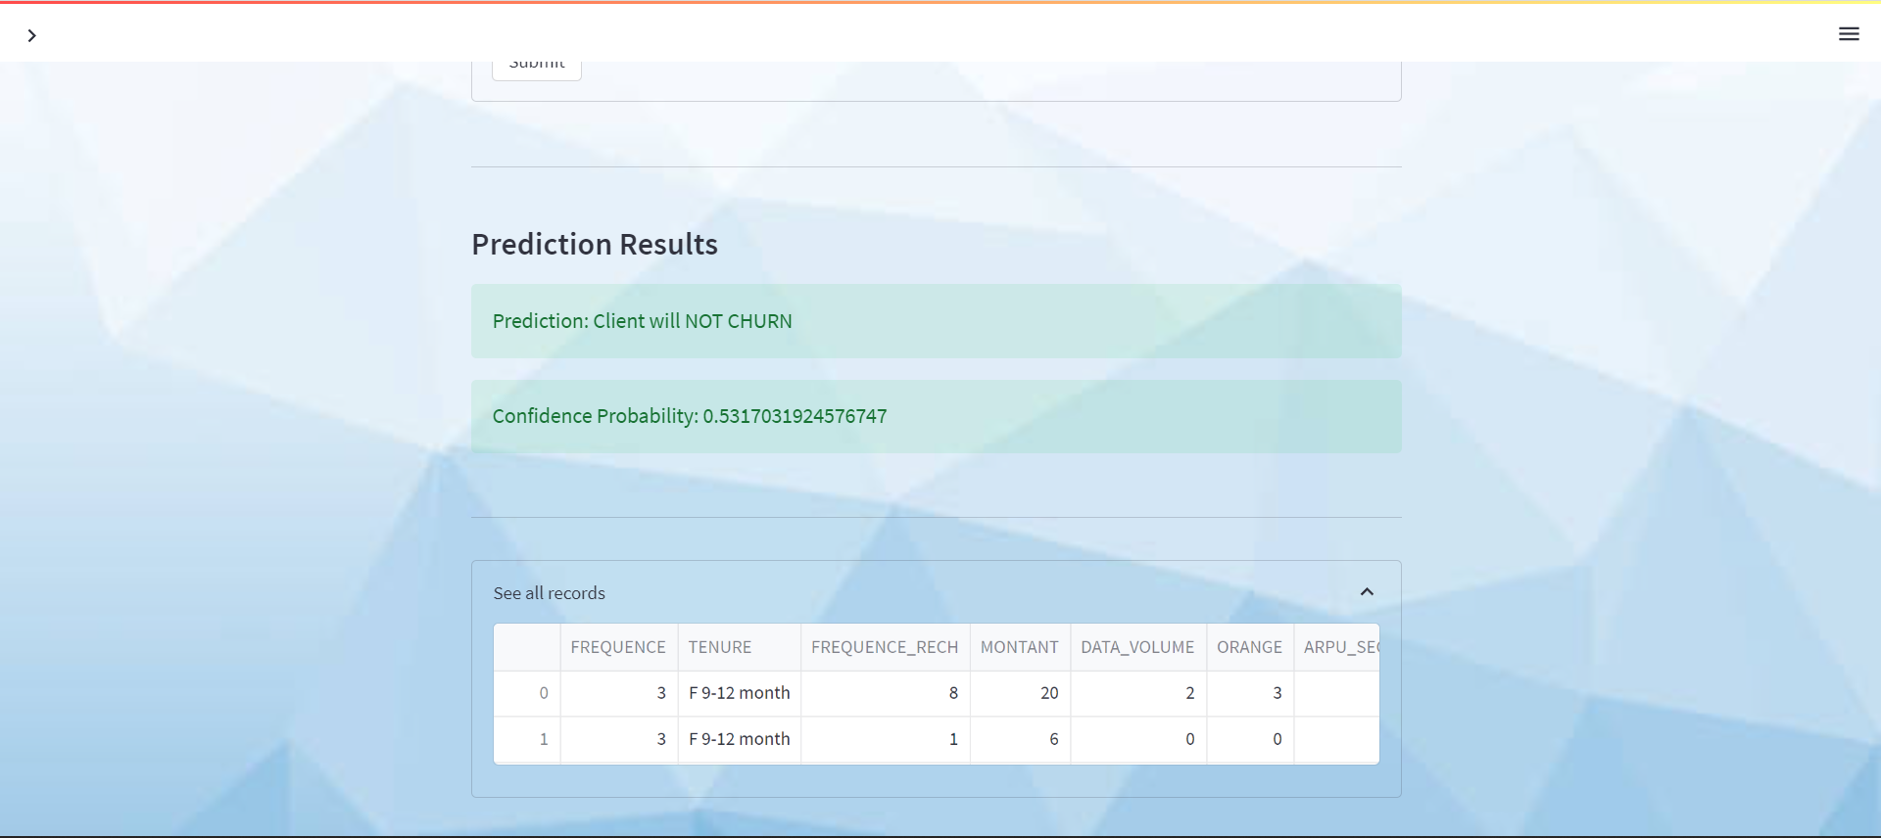
Deployment
A web App was developed using Streamlit to deploy the model

Slide 9
THANK YOU

